Slide 1


San Francisco Building Permits Dataset
EDA Project
Submitted By: Rohit Bele
Registration Number: 12015904
Roll No: K20RUB41

Slide 2
Page Number | Topic
3 | Introduction
4 | Reason for choosing dataset
5 | Insights to get from dataset
6 | Library Used
7 | Data Cleaning
8 | Analysis
17 | Conclusion
18 | GitHub Link
19 | References
Table of Contents

Slide 3
Introduction
Dataset contains all the records of the building permits issued in between Jan 1st, 2013, to Feb 25th, 2018, describing how the issuance of a permit affects the housing sector.
The data was downloaded using the filter in San Francisco open data portal which is being maintained and updated by the San Francisco open data portal.
Notes:
How presentation will benefit audience: Adult learners are more interested in a subject if they know how or why it is important to them.
Presenter’s level of expertise in the subject: Briefly state your credentials in this area, or explain why participants should listen to you.

Slide 4

Why chose the SF Building Permit Dataset?
Building permits are complex and because they are dependent on so many factors, you really need to check with both your city and probably a construction professional to make sure everything adheres to that area's requirements.
You may not need a permit at all, or one could be issued on the spot, but check first because building without a permit will cause a significant headache and will cost a good deal of money.
Every human wants to build their house or buy one but this dream of his/her is left unfulfilled due to some issue with the building permit or the issuing authority.
With this analysis of dataset we could draw some insights on whether the particular permit will be approved or not.
If yes then how long will take it to get approved.
Notes:
Lesson descriptions should be brief.

Slide 5

What are the insights I want to retrieve from the dataset?
Which permit takes the most time to get approved after filing date?
Which permit type has the most demand ?
Which sector has the most Permit types?
The permit is issued for which type of work in the building?
And many more………
Notes:
Example objectives
At the end of this lesson, you will be able to:
Save files to the team Web server.
Move files to different locations on the team Web server.
Share files on the team Web server.

Slide 6

Library Used
NumPy
Pandas
Matplotlib
Seaborn

Slide 7
Data Cleaning
Shape of the original dataset is 198900*42 i.e., there are almost 2Lakh rows and 42 columns in the dataset.
But out of 42 columns only 11 are of our used as rest of them contains the 26% of the invalid data of the total dataset.
Rest of data which is almost 76% , is valid data which could be considered for further analysis.
For example, Street Number suffix and the Zip code contains almost 99% missing values, therefore it was required to drop the columns
In rest of the data the columns which have more than 10Thousand of missing values are dropped.

Slide 8

This Photo by Unknown Author is licensed under CC BY

Slide 9
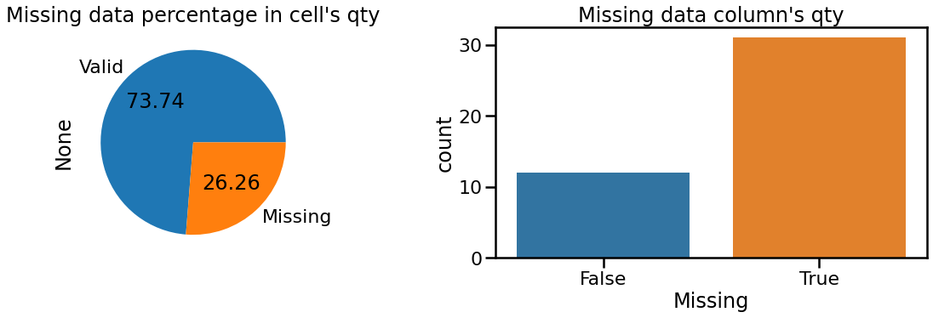
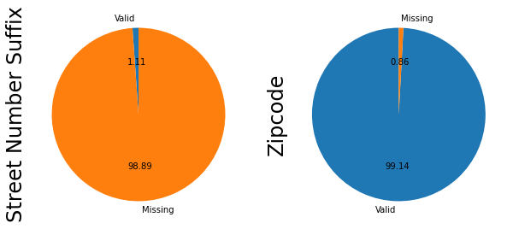

Slide 10
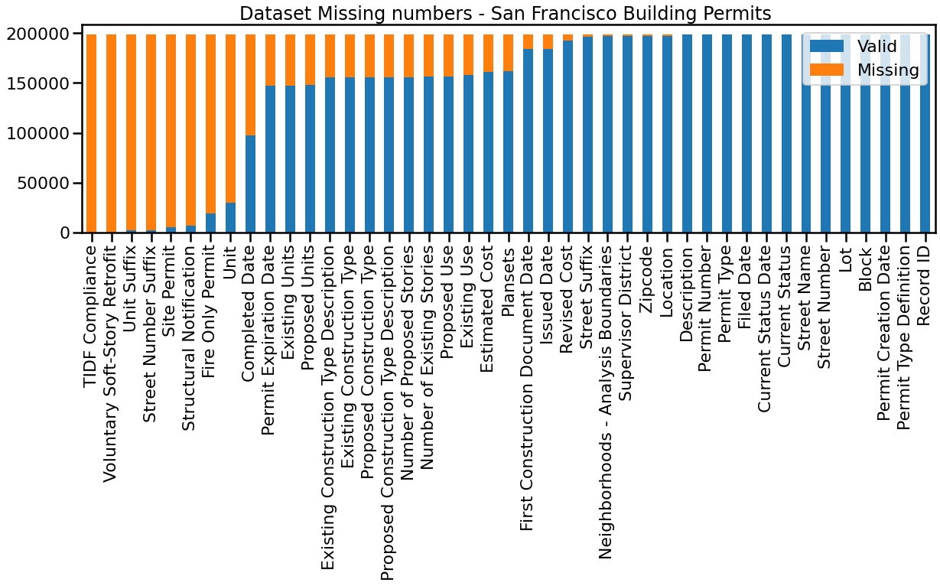

Slide 11
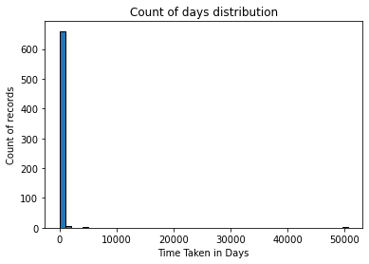
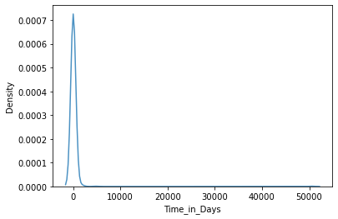

Slide 12
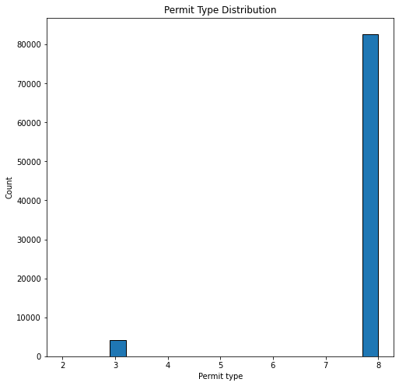
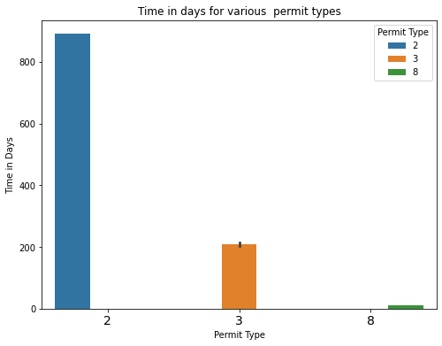

Slide 13
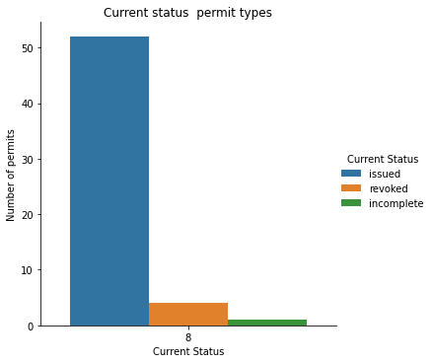
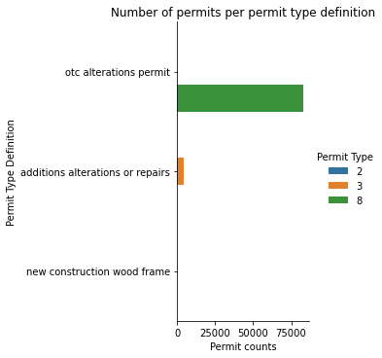

Slide 14
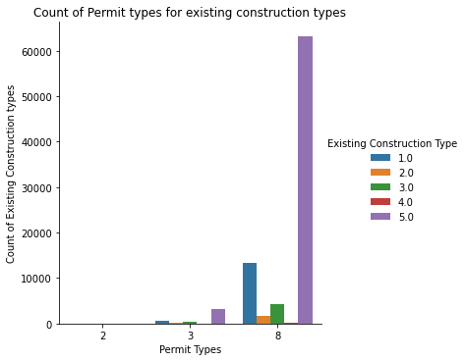
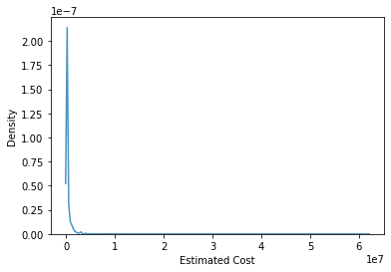

Slide 15
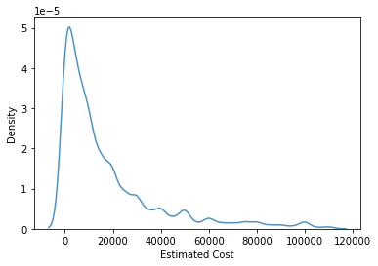
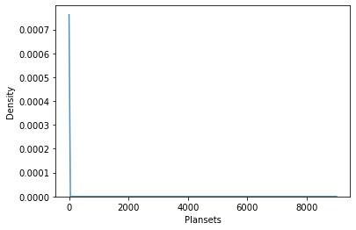

Slide 16
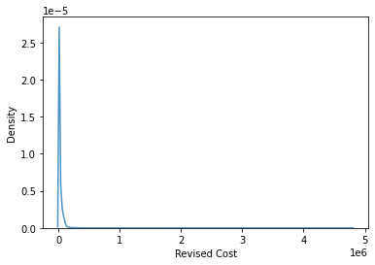
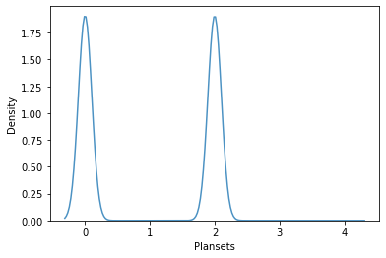

Slide 17
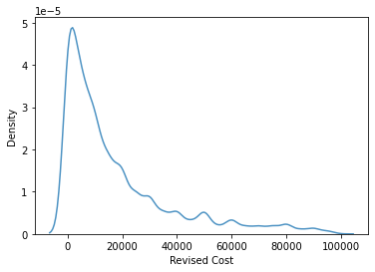
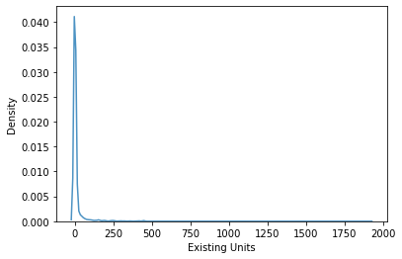

Slide 18
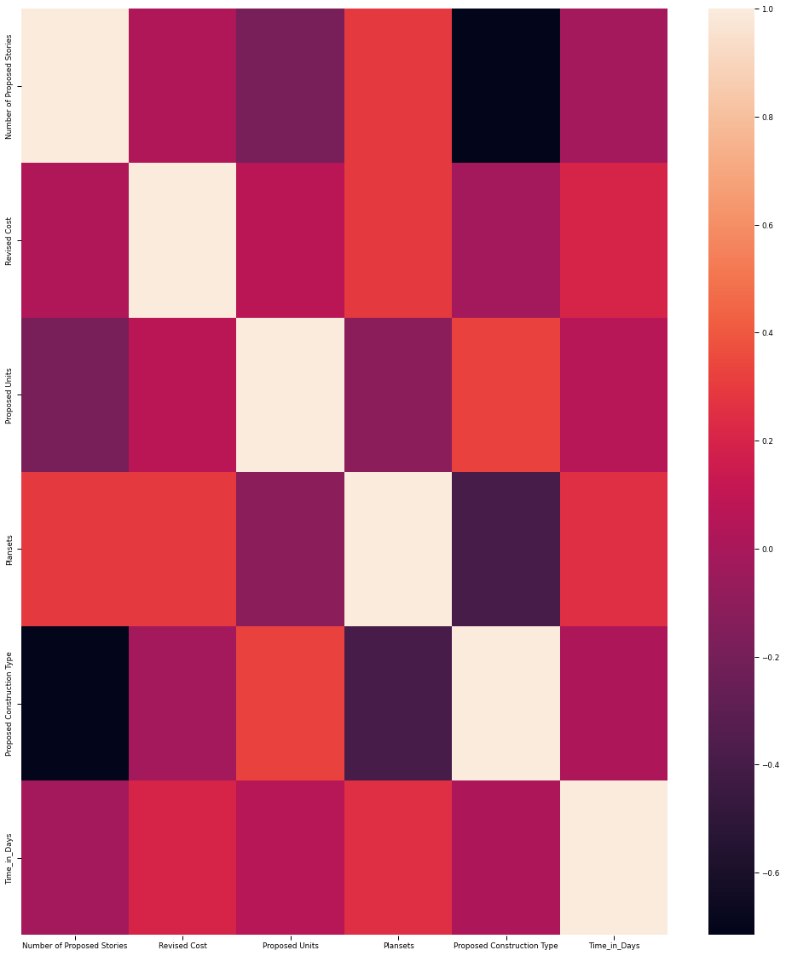

Slide 19
Conclusion
Permit type 2 takes the highest time to get issued by the government authority. Because Type 2 permit is the type of permit which permits several different types of work but don’t change how the building is used. Such as plumbing and interior renovation. Also permit type 8 takes the least to process.
most of the permits are filed in the first four months of the year. most of the permits are also issued in the first four months of the year and very few of them would of them takes more than that. This permit could of type 2 as we know that they takes longer to get issued.
there are more permits that are issued, a few permits that are revoked and a slight number of them that are incomplete meaning that there are more chances for a permit to be issued once all required documents have been submitted.
There a decent correlation between the months of Issues Date and Filed Date features so got to investigate those. Out of all these, I will be completely ignoring the features such as Street Names and Prefix along with record ID, among others. This is because they don't provide enough insights or provide insights that are already too obvious.
Alterations permits are the common permits type definition in the data with other permits definitions greatly skewed.
The most construction types permits issued belong to Existing Construction type 5.0 which is reflected across the major permit types 8 and 3, then followed by construction type 1.0 ,3.0,2.0 and least number of permits belong to construction type 4.0.
Almost 77.2% of all data residential type of data has the highest permits.

Slide 20
GitHub Link
https://github.com/BeleRohit

Slide 21

References
Kaggle
GitHub
UpGrad Learn

Slide 22


